Slide 1
Kingdom: Protista
By
Dr. Hesnaa Saeed Al-Mossawi

Slide 2
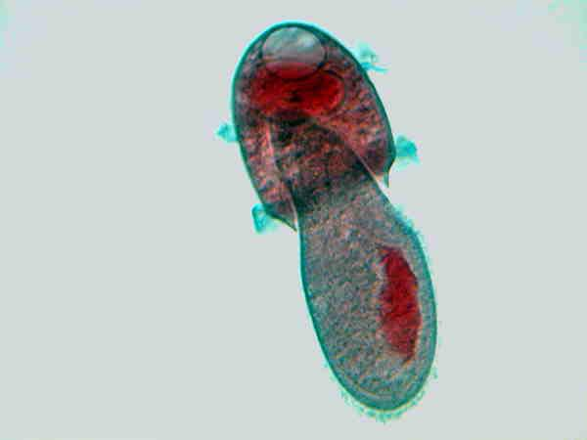
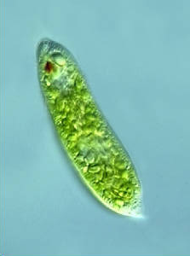
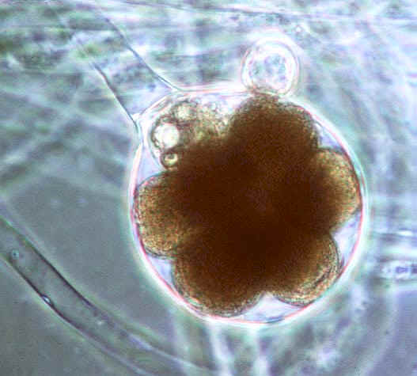
Kingdom: Protista
Didinium
Protists are unicellular organisms that
have a nucleus.
Can be classified according to
their nutrition:
Animal-like—heterotrophs
(eat other organisms)
b. Plant-like—autotrophs
They contain chloroplasts
and make their own food
(photosynthesis).
Fungus-like—
Decomposers/Heterotrophs
Paramecium
Green like plants!
Water mold

Slide 3
Animal-like Protists (Protozoans)
Called Protozoans
Unicellular
Require water (live in water or moist soil)
Most heterotrophic
Some photosynthetic
Most are free-living
Some parasitic
Classified according to the Method of Movement:
  Cilia—hair-like projections used for movement and feeding
  Cytoplasmic streaming—pseudopod (false foot) extends and cytoplasm streams into it.
  Have a Flagellum: a long whip-like structure used for movement.
  all Sporozans are parasites(no movements) ,They feed on cells and body fluids, formed from Spores (tiny reproductive cells).

Slide 4
II. Plant-like Protists (Algae)
Unicellular and Multicellular
Colonies (groups of unicellular protists)
Can move on their own
Autotrophs: make their own food from simple materials using light energy (photosynthesis).
Pigments: chemicals that produce color
Unicellular Algae:
  Phytoplankton provides a source of nourishment for other organisms
  b. Protists recycle sewage and waste materials.
  Algal blooms are harmful when overgrown—deplete water of nutrients consequently killing fish.
Multicellular Algae:
  Red Algae
  Green Algae
  Brown Algae

Slide 5
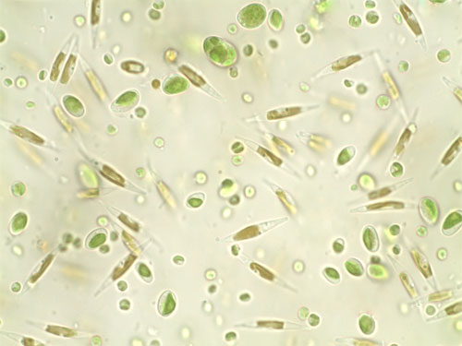
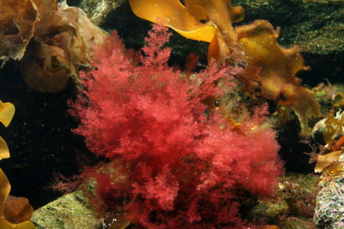
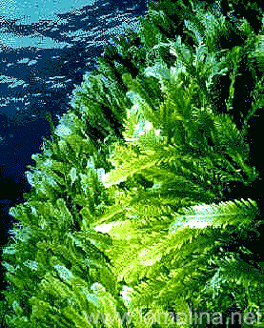
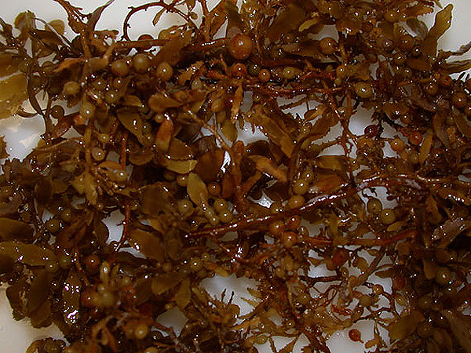

Slide 6
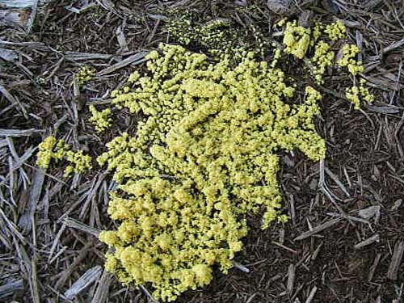
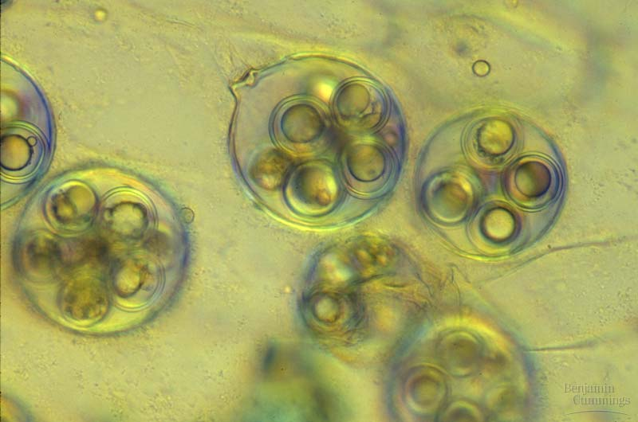
III. Fungus-like Protista
Heterotrophs
Have cell walls.
Many have flagella and are able to move at some point in their lives.
Three types: Slime Molds, Water & Downy Molds
Reproduce with Spores (tiny cell that is able to grow into a new organism)
  Beneficial—
    Recycles dead organic material providing nutrients for plants.
Harmful
Phytophthora Infestans (water mold) caused Great Potato Famine in Ireland

Slide 7
Protozoa -protistae
Protozoa
  Amoeba
    Entamoeba histolytica
    Naegleria
    Acanthamoeba
  Flagellates
    Giardia lamblia
    Trichomonas vaginalis
    Trypanosoma
    Leishmania
  Ciliates
    Balantidium coli
  Sporozoa
    Plasmodium
    Cryptosporidium
    Toxoplasma

Slide 8
